Slide 1
Textbook Affordability
at the College of DuPage
College Course Materials Task Force
July 21, 2022
Dr. Denise Cote
Professor & Reference Librarian

Slide 2
Timeline
2017: Research Study
2018: OER Summit Illinois Community Colleges
2019: Formation of OER Steering Committee, goals for pilot initiative, Board approved yearly budget.
2019-Present: Grant-funds published 54 projects by 118 faculty members. Outreach to 1700 full and part time faculty. Saved students $3M in textbook costs.

Slide 3
OER Steering Committee
Dr. Mark Curtis-Chavez, Provost, Chair
Dr. Denise Cote, Professor/Librarian, Co-Chair
Ten Classroom faculty from all divisions
Two Academic Administrators
AVP of Financial Affairs.
Two Learning Technologists
Manager Student Affairs
Bookstore Manager, Ex Officio

Slide 4
Average Textbook Cost at COD
New - Used
FA 2021: $178.00 - $133.00
SP 2022: $206.00 - $164.00
Notes:
Student spending on course materials is declining, probably because students are choosing to pay for food, housing, and other essentials instead. Also other factors like different purchasing types, increase in the use of no-cost materials by faculty, etc. Our students spent 6M in our bookstore in the last fiscal year.

Slide 5
Affordability Approaches
Open Educational Resources
Open Access Scholarship
Library Materials
Lower-cost commercial

Slide 6
OER Steering Committee
2019-2022
Description | Budget
Faculty Non-Teaching Assignments | $127,600.00
Conferences & Meetings | $6500.00
Dues & Memberships | $6900.00
Other Contractual Services | $9000.00
Total | $150,0000

Slide 7
Student Savings & Students Effected
2019-2022

Slide 8
Grant Project Types
Reassigned or Stipend
Original Writing
Remix/Reuse
As-is Adoption of OER
Resource List (Open Collection)
Library-materials
Textbook Ancillaries

Slide 9
Faculty Grant Projects
(118 participants)
Academic Year (FA, SP, SU) | Number of New Projects | Est. Student Savings per AY
2019-2020 | 19 | $981,000
2020-2021 | 17 | $320,000
2021-2022 | 17 | $580,174

Slide 10
Outreach and Training
Survey on attitudes about OER
Focus Groups on attitudes toward textbooks
Training program reached 400+ Faculty
200 faculty, staff, and administrators sent to OpenEd conference
Outreach to individual faculty members

Slide 11
COD Open Publishing
Textbooks
Open Collections
Ancillaries

Slide 13
Notes:
College of DuPage Digital Press
COD Google Drive

Slide 14
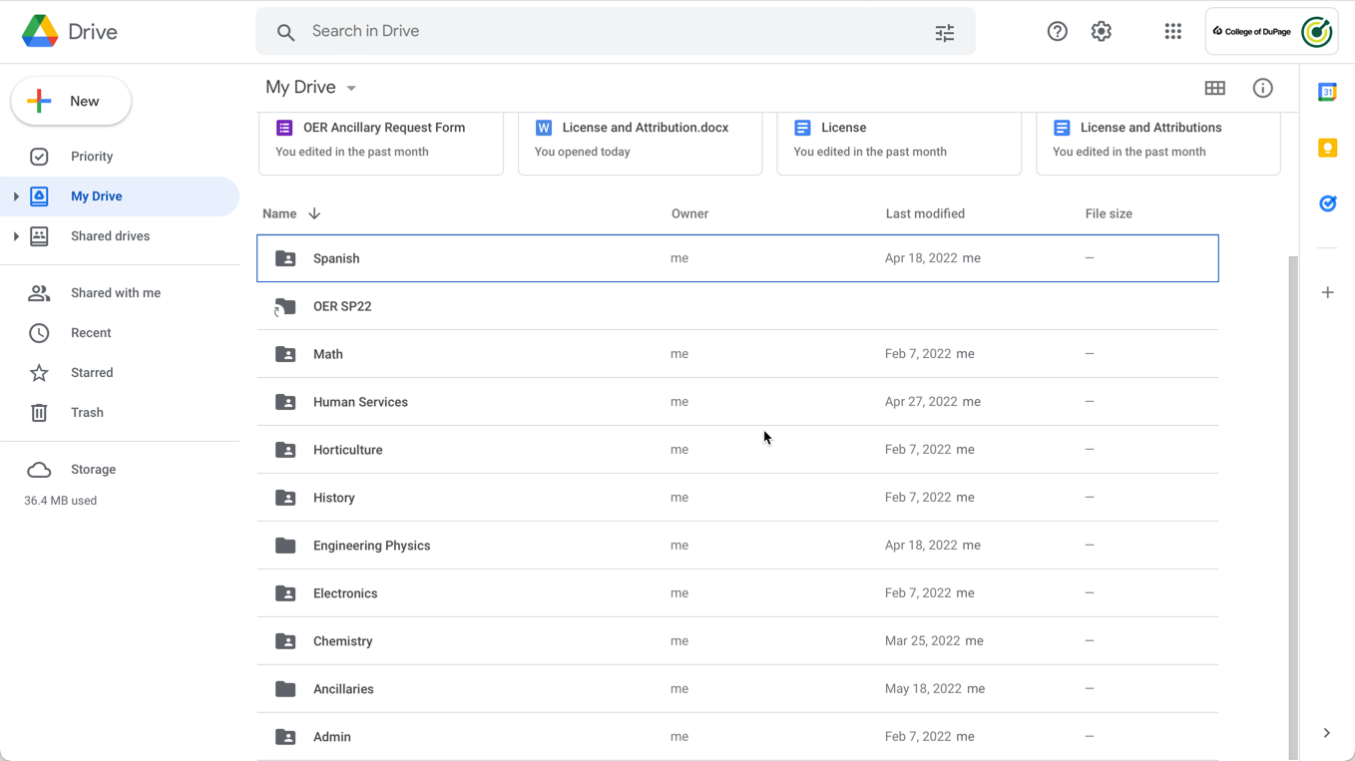
Notes:
College of DuPage Digital Press
COD Google Drive

Slide 15
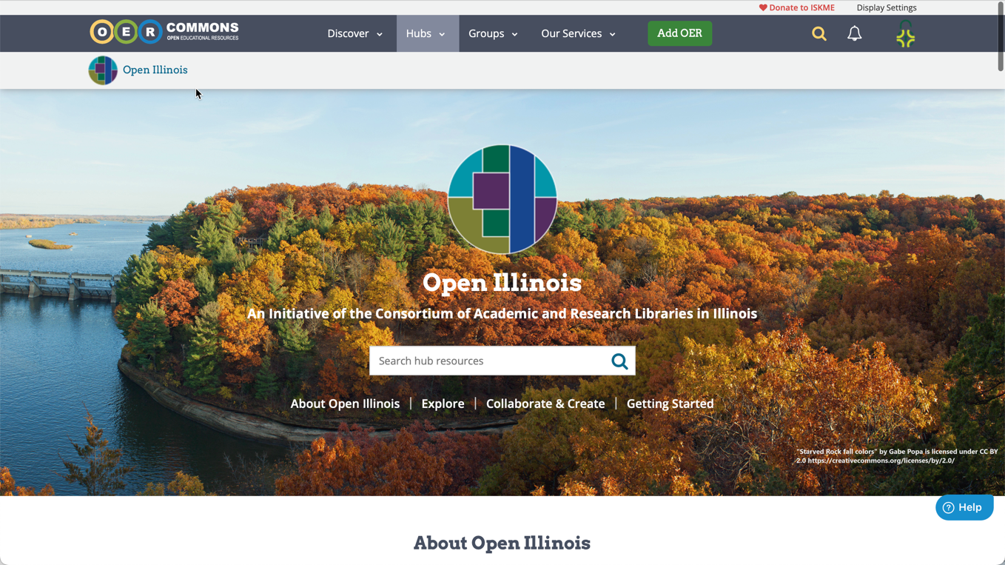
Notes:
College of DuPage Digital Press
COD Google Drive

Slide 16
Other Savings Options
Spring 2021:
497 Faculty chose commercial course materials costing under $50.00

Slide 17
Other ways to save
Older Editions
Rethinking Publishers
Library

Slide 18
Moving Forward
Sustainability of OER
Accessibility
Zero-Textbook Cost Programs
Zero-Textbook Cost Gen Ed Degree
Leveraging library materials
Partnerships with peer colleges
Grant Opportunities

Slide 19
Thank you!
http://opencod.edu

