Slide 1
Affordability and Equitable Access in Course Materials

Slide 2
Conversation on:
- What is Cengage Unlimited for Institutions (CUI)
- What is “AER”
- The importance of equitable access to materials

Slide 3

Notes:
https://cengage.widen.net/view/pdf/tgwca26kgf/cui-ivy-tech-case-study-2019885.pdf?t.download=true&u=lpaabn

Slide 4
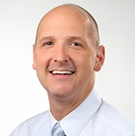
“Cengage Unlimited is really a well-rounded suite of content that can help students succeed in multiple ways. From individual coursework to career readiness, it’s something that’s a little bit more holistic than just what you might think of as traditional textbooks.”
Justin Dammeier
Executive Director, Education Technology
Ivy Tech Community College

Slide 5
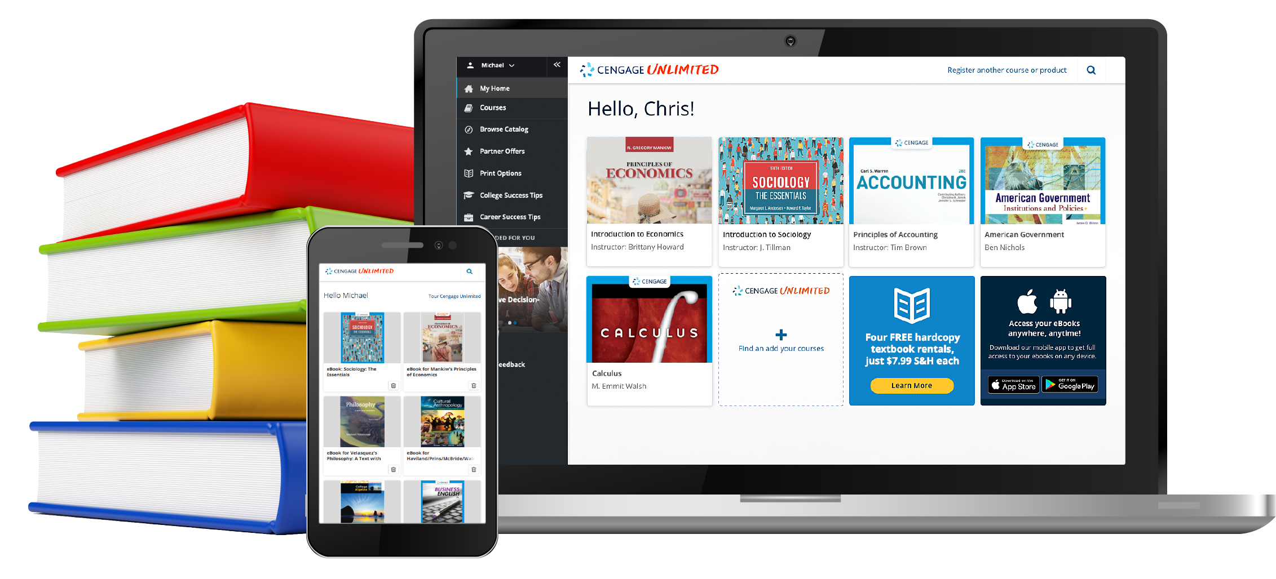
Cengage Unlimited
One Subscription. One Price. Unlimited Learning.
Cengage Unlimited is the industry’s first affordable and scalable subscription that includes access to every Cengage online homework platform, all eTextbooks across disciplines and more. It’s access to everything in one place, for one price.
With Cengage Unlimited, students save money, time and hassle when accessing course materials.
Cengage Unlimited has saved students over $490 million across nearly 4 million unique users.
Notes:
Instead of being a one course to one book solution it gives students (and faculty) access to every Cengage online homework platform, all eTextbooks across disciplines and more all at one low price.

Slide 6
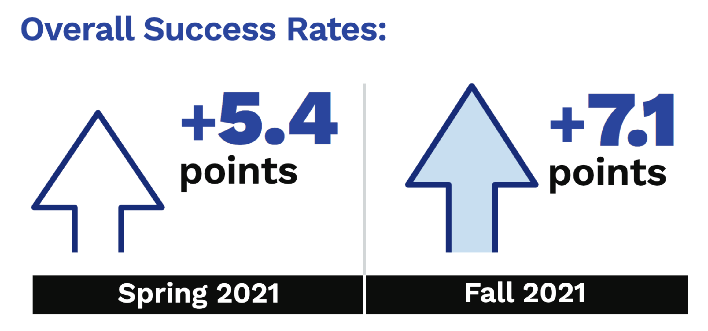
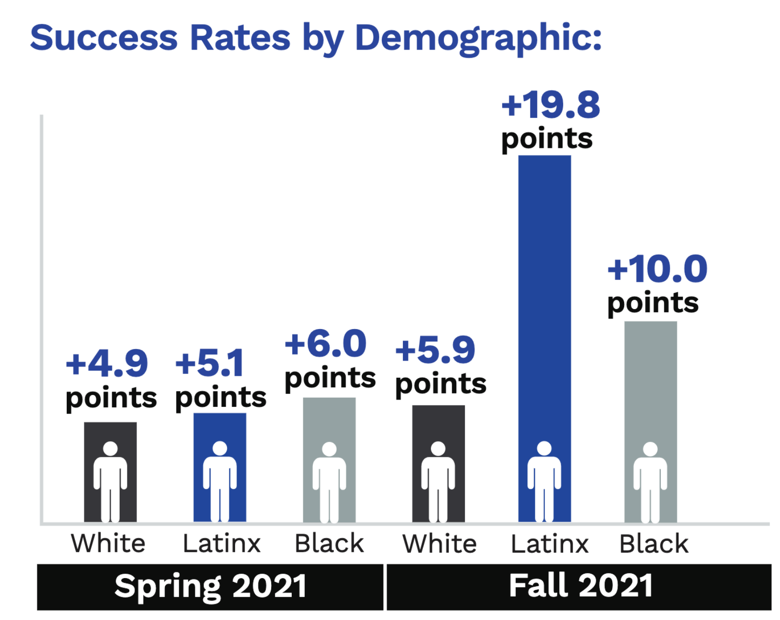
Ivy Tech Realizes 7 Percent Differentiation in Student Success with Cengage Unlimited
Notes:
Based on their institutional study: After a thorough analysis of the student success data from fall 2020 and fall
2021, the overall result was that students who accessed Cengage Unlimited
materials in their courses had 5% higher success rates than students
in non-Cengage course sections. That number grew to 7% in fall 2021,
suggesting that Cengage Unlimited is a growing differentiator for
success for Ivy Tech students.
A breakdown of demographic segments demonstrated even higher
differentiators in student success in certain segments of the student
population. The greatest gain was a nearly 20 percentage point
differentiator for Latinx students.

Slide 7
Affordable Educational Resources

Slide 8
“Every student should have an equal opportunity to succeed and having the right learning materials can have a critical impact on performance. The high cost of textbooks have prohibited this for many students. This is why we launched Cengage Unlimited – to make quality learning more affordable.”
Michael Hansen
Chief Executive Officer
Cengage
Notes:
We just finished up our third year of Cengage Unlimited, which was developed when our CEO acknowledged that the high costs of textbooks were a problem and came up with a solution. No other publisher has this unique model that focuses on success of the student as a whole.

Slide 9
Affordable Educational Resources (AER)
Affordable Educational Resources
Open Educational Resources
Traditional Textbook Model
No student textbook costs*
High faculty time investment for creating and maintaining resources
High student textbook costs
Low faculty time investment in maintaining resources
Cengage Unlimited for Institutions
Inclusive Access
Notes:
From one of our institutional partners

Slide 10


Top Illinois Schools Saving with Cengage Unlimited
1 | University of Illinois – Urbana Champaign | $1.52M
2 | Illinois State University | $945K
3 | Joliet Junior College | $740K
4 | College of Lake County | $593K
5 | University of Illinois - Chicago | $547K
33K+
Students in Illinois used Cengage Unlimited last year
Illinois college students using Cengage Unlimited have saved around
$10M

Slide 11
Equitable Access to Course Materials

Slide 12



Equality vs. Equity in Course Materials
EQUALITY
EQUITY
Giving all students the same tools to succeed
Giving students access to the various resources they need to succeed while still focusing on outcomes
ADDITIONAL FACTORS:
Providing affordable, quality course materials Ability to customize content
Notes:
While they may be EQUAL- they are not EQUITABLE.
There are more factors to equity than affordability.

Slide 13
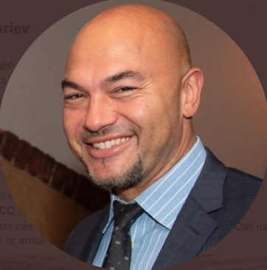
“In the past, we would have one textbook, generally speaking, per course... With Cengage Unlimited, faculty are excited, because now they can take the best of several different books, or resources, open education resources that they're curating.”
Bernard Polnariev
Assistant Vice President of Academic Affairs & Dean, Scotch Plains Campus
Union County College

Slide 14
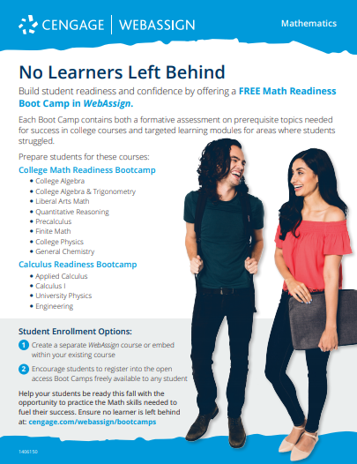

Meeting Students Where They Are
Math Readiness Boot Camp
English Just in Time +, Writing Guides & Gale College Collection
Notes:
For math readiness: https://webassign.com/math-readiness-bootcamps/
English tools: https://www.cengage.com/discipline-english/just-one-thing/

Slide 15
Value Beyond the Course
College Success Resources
Career Success Resources
Study Tools for 40+ Foundational Courses
(Test Prep, Videos, Quizzes, Flashcards, Study Guides)
Notes:
At Cengage, we want to give students the tools to succeed not just in their course, but overall. We provide resources for college success and a career center to enhance their overall experience as well as provide study tools to give them the real-time help they need to succeed.

Slide 16
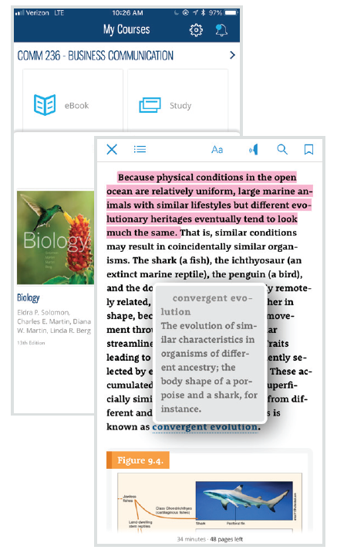
Elevate Engagement: Cengage Mobile App
Make Reading Convenient: Online or Off, Highlight, Take Notes & Listen
Polling & Attendance to encourage participation
Study Tools: Flashcards and practice quizzes to cultivate confidence
Review Grades, Activity Updates & Due Date Reminders
Access College Success & Career Center Activities
https://acrobat.adobe.com/link/review?uri=urn:aaid:scds:US:8ac15082-5abe-3cb7-8da5-cca5a31b8211
Notes:
How do you elevate engagement and reach students any time/anywhere?

Slide 17

”Cengage Unlimited takes the stress away from having to worry about finances during each semester so that all of my focus is on academic work. You're literally getting hundreds of books for the price of one!”
Gleimy Rodriguez
Student
University of Connecticut
Notes:
http://embed.widencdn.net/pdf/plus/cengage/po5ennfazv/student-suc…e-unlimited-rodriguez-m190000798571.pdf

Slide 18

Tools to Help Instructors Be Their Best

Slide 19

“Our goal is to deliver quality learning experiences to all learners. Inclusivity is one of our core learning design principles. If a learning experience can’t be accessed by all learners, it doesn’t live up to our standard of quality learning.”
Justin Tumelaire
Accessibility Manager
Cengage

Slide 20
Equity By Design
Design standards and best practices:
Accessible for students with disabilities –https://www.cengagegroup.com/accessibility/
Agile development to remain current and relevant
Third-party links continuously validated and updated
Student Experience:
Interactive, visual, and engaging (simulations, animations, videos)
Integrated assessments and grading
Personalized learning, including tutoring
Student and Faculty Support:
Student and faculty training with 24/7/365 tech support
Faculty have unlimited access to materials for course development
Notes:
Equity by design to ensure accessible, interactive and engaging material with 24/7/365 support

Slide 21
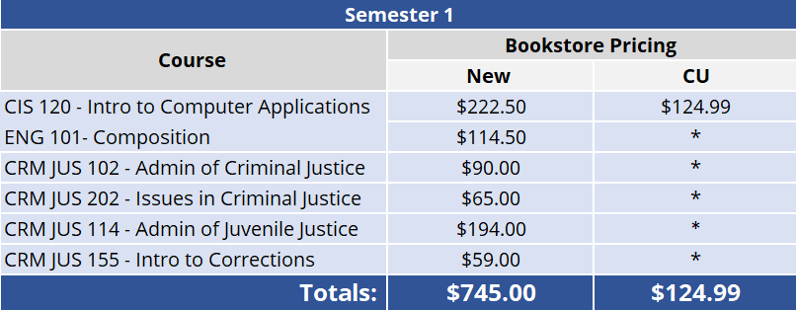
Course Path Example: Pathway to Policing
Notes:
An example to show current cost for a student by course in a CUI program
*Under $21/course for unlimited access to Courseware, eBooks and study tools (under $7/credit hour)
Can supplement instructor-choice/OER

Slide 22

“The pandemic has shone a light, and in many cases, exacerbated, the inequities that exist in education. But it also presents an opportunity for us all to be bold, and create a system that is more accessible, affordable, relevant and just for all students, allowing them to succeed and thrive.”
Alexandra Bernadotte
Founder and CEO of Beyond 12
Cengage Board of Directors

